Slide 1
FaceBook
EECS-332 Digital Image Analysis
Liu Liu
Yuchun Zhou
Chi Zhou

Slide 2
OUTLINE
GOAL
FINAL DEMO
STEPS
IMPROVEMENT

Slide 3
GOAL
Face Detection
Face Tracking
Face Recognition
Real - time face recognition∗

Slide 4
FINAL DEMO
https://www.youtube.com/watch?v=POQwaNeRXnk

Slide 5
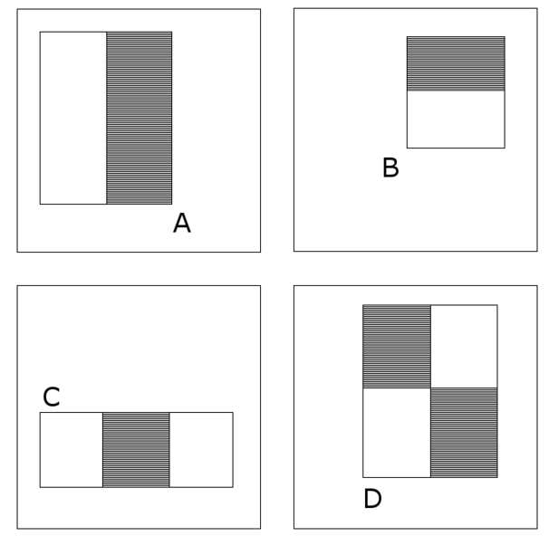
STEP 1 --- Face Detection
Viola-Jones Algorithm
Feature types and evaluation : integral image
Classifier : AdaBoosting algorithm
Speedup : Cascading classifiers
Finally, putting things together

Slide 6
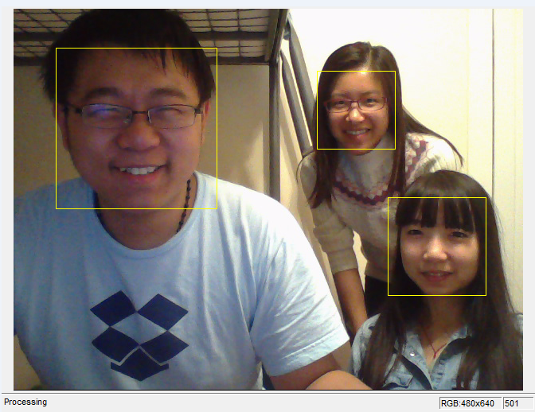

Slide 7
STEP 2 --- Face Tracking
Eigenvalue Algorithm
Find corners
Polygon

Slide 8
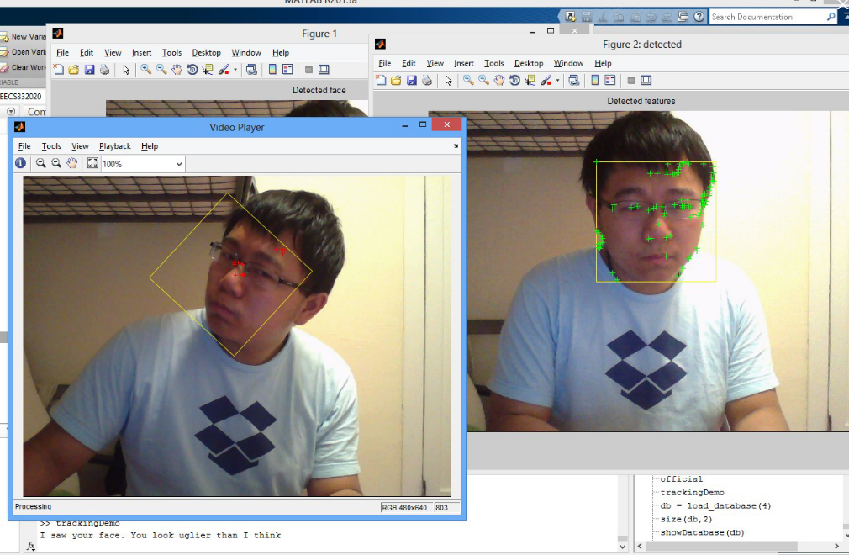

Slide 9
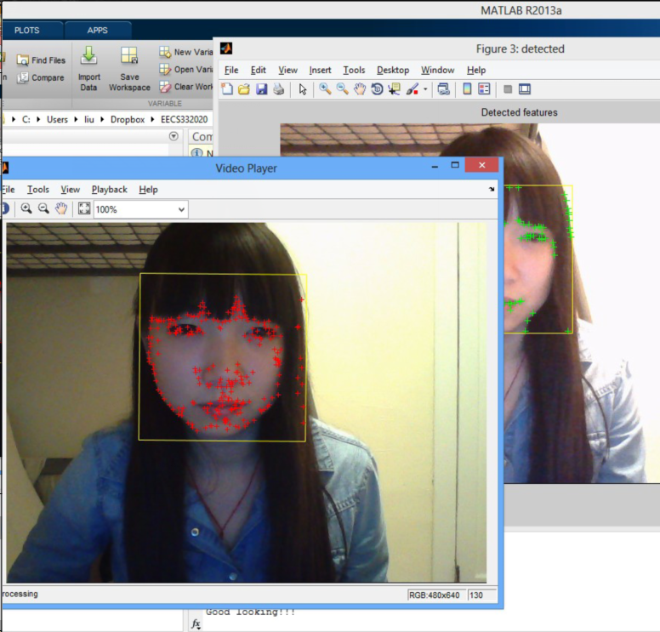

Slide 10
STEP 3 --- Training
∗ Take real-time pictures of a person
∗ Set the size of images to 112* 92
∗ Save the training images of every person into a database folder

Slide 11
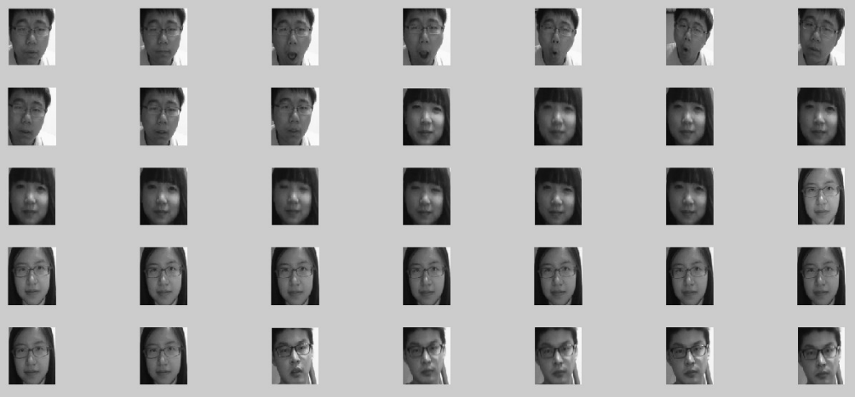
STEP 3 --- Training
Database

Slide 12
STEP 4 --- Face Recognition
Principal Component Analysis Algorithm
√ Not much preprocessing
√ Easy to realize
√ Simple steps
√ Compress images and save computations
× Not resistant to interference
× Small samples

Slide 13
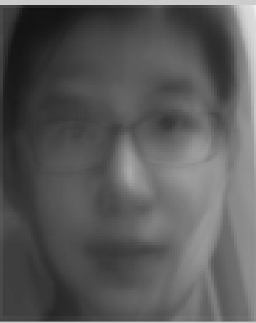
STEP 4 --- Face Recognition
Deriving the Eigenface Basis
Calculate the average face in face space

Slide 14
STEP 4 --- Face Recognition
Compute each face’s difference from the average
Compute a covariance matrix (C) for our dataset

Slide 15
STEP 4 --- Face Recognition
Simplifying the Initial Eigenface Basis
N M
N: the number of pixels in our image
M:the number of images in our dataset

Slide 16
IMPROVEMENT
More robust face detection
Multi-faces tracking
Creating GUI

Slide 17
Thanks !

